Slide 1
Java GUI

Slide 2
Introduction to GUI Programming
Users interact with modern application programs using graphical components such as windows, buttons, text boxes, and menus. It would be difficult to write a GUI application from scratch. Luckily, most of the work has been done for you in a set of classes called Swing.
A graphical user interface consists of graphical components, such as:
Windows
Buttons
Menus
Text fields
Swing components are based on the fundamental classes of the Abstract Windowing Toolkit (AWT). Swing components come with recent java Java releases. If you download the most recent release of Java, Swing will be part of it.
The older AWT components are similar to Swing components, but Swing components are more versatile. Also, Swing integrates smoothly with the Java Foundation Classes. Sun Microsystems recommends that you use Swing for all new application code.

Slide 3
Events
A GUI application program shows the user a graphical interface containing several graphical components.
The user controls the application by interacting with the graphical components, doing such things as:
Clicking on a button to choose a program option.
Making a choice from a menu.
Entering text in a text field.
Dragging a scroll bar.
An action such as clicking on a button is called an event.

Slide 4
Event-driven Programming
When you perform an action on a graphical component you generate an event. In event-driven programming the program responds to these events. The order of the events is determined by the user, not the program.
This is different from programs where user interaction is done through the console. In these programs, prompts are written to the console, and the user responds to the prompts. The order of the prompts is determined by the program.

Slide 5
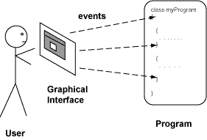
Responding to Events
A user interacts with a GUI application by causing events.
The application responds to events in the order they arrive.
The picture shows this. Each time the user interacts with a component, an event is sent to the application.
Different events are sent to different parts of the application. The application has to work correctly no matter what the user does.
An application usually ignores events that are not relevant to its purpose.

Slide 6
Three Parts of a GUI Program
A GUI program has three parts:
Graphical Components that make up the Graphical User Interface.
Listener methods that receive the events and respond to them.
Application methods that do useful work for the user.
The graphical components are Swing objects. You usually extend them to make them fit your application.
Listener methods are Java methods that you write. Listener methods respond to events by calling application methods.
Application methods are ordinary Java methods that perform useful computations. They receive data from the GUI and send data to the GUI to be displayed, but are not usually themselves concerned with the user interface.
To write a GUI application, keep these three types of software separated (while keeping the big picture in mind).

Slide 7
Container Classes
A GUI program consists of a collection of graphical components that are all placed inside one or more windows.
The components are contained by the window. A container is an object that can hold other GUI components. Visually, a container is an area of the screen and the objects it contains are shown as smaller areas within it.
In Java terminology, a window (such as the browser window you are looking at) is a container. Buttons, sliders, icons and other GUI components are always put in container.

Slide 8
JFrame
A JFrame represents the window of a GUI application program. It can hold the components and methods that your application needs.
The JFrame class.
Methods:
The setSize() method.
The setBounds() method.
The setVisible() method.
The setDefaultCloseOperation() method.
Extending the JFrame class
The JLabel class.

Slide 9
Frames
Graphical components must be placed inside a container. A container corresponds to a rectangular area of the monitor screen, and the components it contains correspond to smaller areas within it.
In Java, a frame is a window that has nice borders, various buttons along the top border, and other features. What you usually call a "window" Java calls a "frame". A frame is a container object, so GUI components can be placed in it.
Like all software objects, a frame object is actually a section of main memory that holds information and methods. With the help of the operating system and the graphics board, Java paints a picture on the computer monitor that represents the frame. People often speak as if the frame were the actual picture on the monitor. In fact, what you see on the monitor is just a graphical representation of the frame.

Slide 10
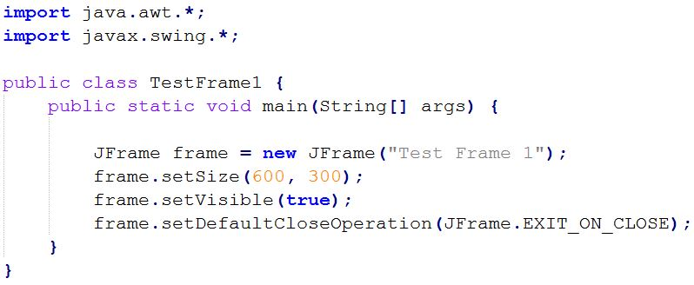
First a JFrame is created by invoking its constuctor. The argument to the constructor sets the title of the frame.
The setSize(200,100) method makes the rectangular area 200 pixels wide by 100 pixels high. The default size of a frame is 0 by 0 pixels.
The setVisible(true) method makes the frame appear on the screen. If you forget to do this, the frame object will exist as an object in memory, but no picture will appear on the screen. A call to setVisible(false) makes the frame invisible, but does not destroy the software object.
It is easy to forget to include setVisible(true). If you run your GUI program, and nothing happens, check that you have called this method.
The setDefaultCloseOperation() method picks the action to perform when the "close" button of the frame is clicked. This is the little X button at the top right of the frame. If you forget to call this method with the appropriate constant, a click on the close button will be ignored.

Slide 11
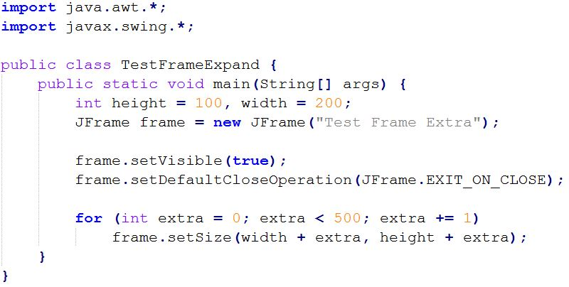
Dimensions of a Frame
The setSize() method of JFrame changes the size of the frame on the computer monitor. The size can be changed as the program runs. For example, the following program works (although it is mostly useless):
The frame starts out with size 200 by 100, and then grows larger.

Slide 12
setBounds() and setDefaultCloseOperation() method
The setBounds() method not only specifies the size of the frame, but the location of the upper left corner:
public void setBounds(int x, int y, int width, int height)
This puts the upper left corner at location (x, y), where x the the number of pixels from the left of the screen and y is is the number from the top of the screen. height and width are as before.
The setDefaultCloseOperation() method is used to specify one of several options for the close button. Use one of the following constants to specify your choice:
JFrame.EXIT_ON_CLOSE — Exit the application.
JFrame.HIDE_ON_CLOSE — Hide the frame, but keep the application running.
JFrame.DISPOSE_ON_CLOSE — Dispose of the frame object, but keep the application running.
JFrame.DO_NOTHING_ON_CLOSE — Ignore the click.
If you forget to call setDefaultCloseOperation() you will get JFrame.HIDE_ON_CLOSE by default.
This can be frustrating, because it looks like you have "killed" the program, but it keeps on running, and you see no frame.

Slide 13
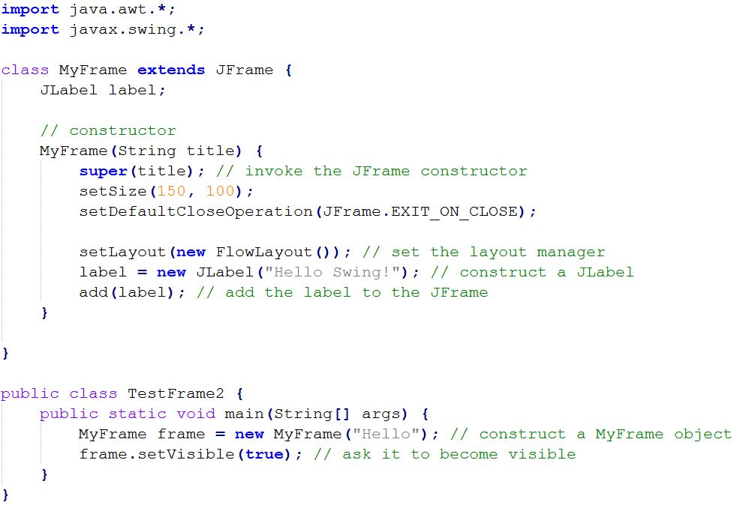
Extending the JFrame Class
To write a GUI application, extend the JFrame class.
Add GUI components to the extended class. Here is a program that does that.

Slide 14
Containers hold Component References
The new class is called MyFrame and it is based on JFrame. Exactly how a container arranges the components it contains is determined by a layout manager. The layout manager for this frame is set to FlowLayout using the setLayout() method.
The frame holds a GUI component, a JLabel which displays the words "Hello Swing!" . The JLabel is added to the frame using the add() method.
The main() method in this application does nothing more than construct a MyFrame object and set it visible.
MyFrame is a Container, because it inherits from JFrame, so GUI components can be added to it. When a component is added to a container, a reference to the component is added to the list of components in the container.
Graphically, the components added to a container appear within the rectangle on the monitor allocated to the container. In the example program, the JLabel is added to the frame, and so appears within that area.

